Slide 1

Manufacturing Analytics & Strategic Insights
Business Intelligence Report covering November 2024 - January 2025 analysis period with 2,937 total records across 12 customers and 335 products.

Slide 2
Key Performance Overview
$60.5M
2,937
100.1%
0.0%
Total Revenue
Total Orders
Operational Efficiency
Profit Margin
Strong market position demonstrated
Active operational volume
Exceeds industry standards
Requires immediate improvement

Slide 3

Critical Business Findings
Revenue Strength
High Risk Concentration
$60.5M total revenue demonstrates strong market position with average order value of $20,587.
Top customer generates 80% of revenue, creating dangerous dependency requiring diversification.
Operational Excellence
100.1% efficiency exceeds targets with excellent cost control showing -0.02% variance.

Slide 4

Revenue Performance Analysis
Financial Metrics
Total revenue: $60,463,085
Average order value: $20,587
Revenue growth rate: -5.3%
Profit margin: 0.02% (improving trend)
Market challenges require strategic attention to reverse negative growth trend and improve profitability.

Slide 5
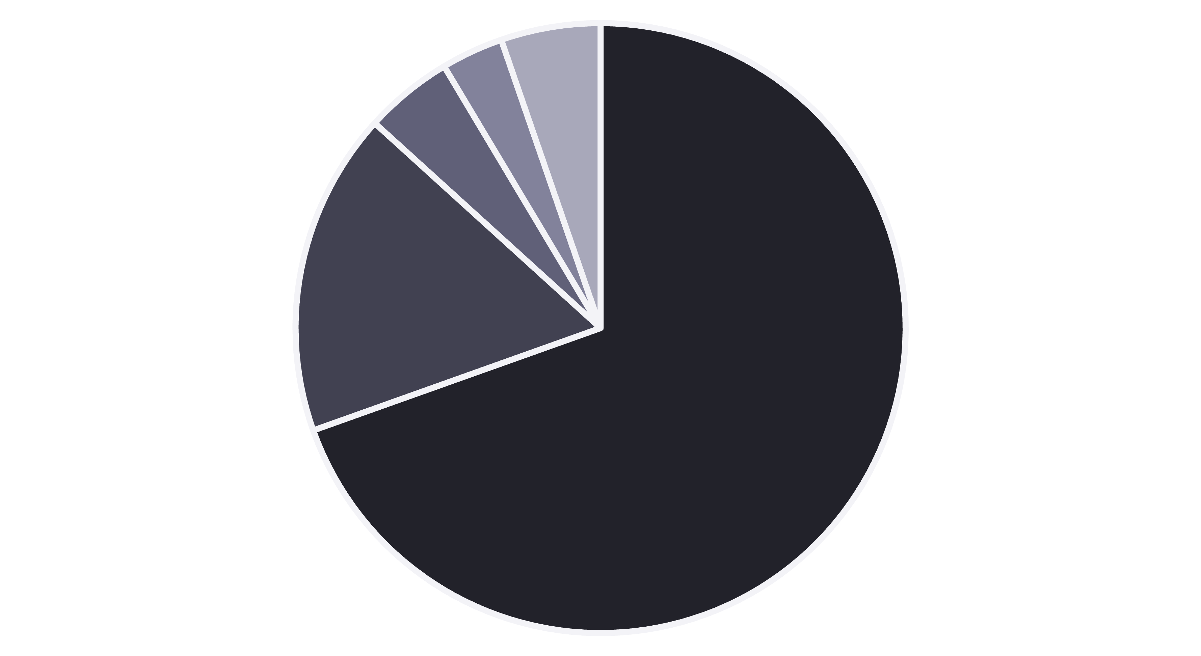
Customer Concentration Risk
Company A
Company C
Company D
Company B
Others
Company A represents 69.6% of total revenue, creating dangerous dependency. Immediate diversification strategy required to mitigate business risk.

Slide 6

Operational Excellence Metrics
100.2%
100.0%
100.1%
Manpower Efficiency
Material Efficiency
Machine Efficiency
Above target performance
Meeting target standards
Exceeding expectations
Overall operational efficiency at 100.1% indicates excellent management and optimization. Cost variance of -0.02% demonstrates superior cost control processes.

Slide 7
Risk Assessment Matrix
Risk Category
Level
Impact
Priority
Customer Concentration
High
High
High
Profit Margin Volatility
Medium
Medium
Medium
Operational Efficiency
Low
Medium
Medium
Cost Control
Low
Medium
High

Slide 8

Strategic Recommendations
01
02
Customer Diversification Strategy
Comprehensive Pricing Review
Reduce dependency on top customers through new acquisition targeting mid-market segments and strategic partnerships.
Conduct value engineering and pricing strategy refinement to improve profit margins from current 0.02%.
03
Digital Analytics Investment
Enhance decision-making capabilities through automation and real-time analytics platform implementation.

Slide 9
Implementation Roadmap
3 Months: Pricing Strategy Review
1
Target: >12% profit margin improvement through comprehensive pricing analysis and value engineering initiatives.
2
6 Months: Customer Diversification
Goal: 20% new customer revenue to reduce concentration risk and strengthen market position.
9 Months: Operational Excellence
3
Target: 105% overall efficiency through lean manufacturing and continuous improvement programs.
4
12 Months: Digital Analytics Platform
Deliverable: Real-time dashboards for enhanced decision-making and performance monitoring.

Slide 10




Critical Success Factors
Leadership Commitment
Clear Communication
Visible support and resource allocation for strategic initiatives across all organizational levels.
Organization-wide understanding of benefits, expected outcomes, and change management processes.
Performance Monitoring
Regular progress reviews, milestone tracking, and course correction based on real-time feedback.

